Slide 1
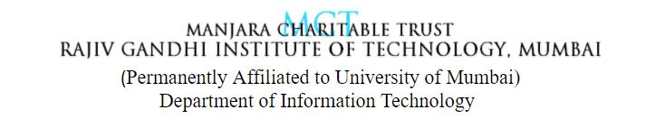
Object Detection
Presented by Group 1-
401- Arshi Bhaldar
405- Debjani Das
413- Ritika Ghanekar
422- Vijetha Kamath
Project Guide:
Dr. S.B. Wankhade

Slide 2
ABSTRACT
In this project, us humans can easily detect and recognize objects from complex scenes in a flash. Translating that thought process to a machine, however, requires us to learn the art of object detection using computer vision algorithms. Our objective is to capture the coordinates of the moving object and highlight that object in the video. Here OpenCV is the huge open-source library for computer vision, machine learning, and image processing and now it plays a major role in real-time operation which is very important in systems. By using it, one can process images and videos to identify objects, faces,etc . The two major objectives of object detection include:
To identify all objects present in an image.
Filter out the object of attention.
There are a number of sub-tasks that we can perform in object detection, such as counting the number of objects, finding the relative size of the objects, or finding the relative distance between the objects.All these sub-tasks are important as they contribute to solving some of the toughest real-world problems.

Slide 3
INTRODUCTION
Object detection is a technology that falls under the broader domain of Computer Vision. It deals with identifying and tracking objects present in images and videos. Object detection has multiple applications such as face detection, vehicle detection, pedestrian counting, self-driving cars, security systems, etc.
The two major objectives of object detection include:
To identify all objects present in an image
Filter out the object of attention

Slide 4
LITERATURE SURVEYED
Object detection is important for computer vision. Problems such as noise, blurring and rotating jitter, etc. with images in the real-world have an important impact on object detection. The objects can be detected in real time using YOLO (You only look once), an algorithm based on convolutional neural networks. This paper addresses the various modifications done to the YOLO network which improves the efficiency of object detection. The components involved in object detection are separated and unified into a single neural network by the YOLO architecture. All bounding boxes are simultaneously projected from the entire image, which means that the network can handle the entire image with all its objects.
Chengji Liu, Yufan Tao, Jiawei Liang, Kai Li1, Yihang Chen in his research mentioned A generalized object detection network was developed by applying complex degradation processes on training sets like noise, blurring, rotating and cropping of images. The model was trained with the degraded training sets which resulted in better generalizing ability and higher robustness.

Slide 5
PROBLEM DEFINITION
As we move towards more complete image understanding, having more precise and detailed object recognition becomes crucial. In this context, one cares not only about classifying images, but also about estimating the class and location of objects contained within the images, a problem known as object detection.
One of the major problems was that of image classification, which is defined as predicting the class of the image. A slightly complicated problem is that of image localization, where the image contains a single object and the system should predict the class of the location of the object in the image (a bounding box around the object). The more complicated problem (this project), of object detection involves both classification and localization.

Slide 6
TECHNOLOGY USED
Deep learning techniques have been proven state of the art for various object detection problems. Following are some of the commonly used deep learning approaches for object detection:
• ImageAI
• Single Shot Detectors
• YOLO (You only look once)
• Region-based Convolutional Neural Networks
ImageAI is a Python library built to empower developers to build applications and systems with self contained deep learning and Computer Vision capabilities. It contains a Python implementation of almost all of the state-of-the-art deep learning algorithms like RetinaNet, YOLOv3, and TinyYOLOv3. ImageAI makes use of several APIs that work offline - it has object detection, video detection, and object tracking APIs that can be called without internet access. ImageAI makes use of a pre-trained model and can easily be customized.
The ObjectDetection class of the ImageAI library contains functions to perform object detection on any image or set of images, using pre-trained models.With ImageAI, you can detect and recognize 80 different kinds of common, everyday objects!

Slide 7
ADVANTAGES AND DISADVANTAGES
The advantages of the object detection system include faster processing, automation of the identity, breach of privacy, massive data storage, best results, enhanced security, real time object detection in schools and colleges, corporate offices and many more in day to day life.
Few disadvantages in this system include the costing, or the funding, very good cameras of high definition are required, poor image quality may limit the effectiveness of this system, size of the image will matter because it becomes difficult to recognize the object in small images, object angles can limit the object detection reliability, massive storage is required for this system to work effectively.

Slide 8
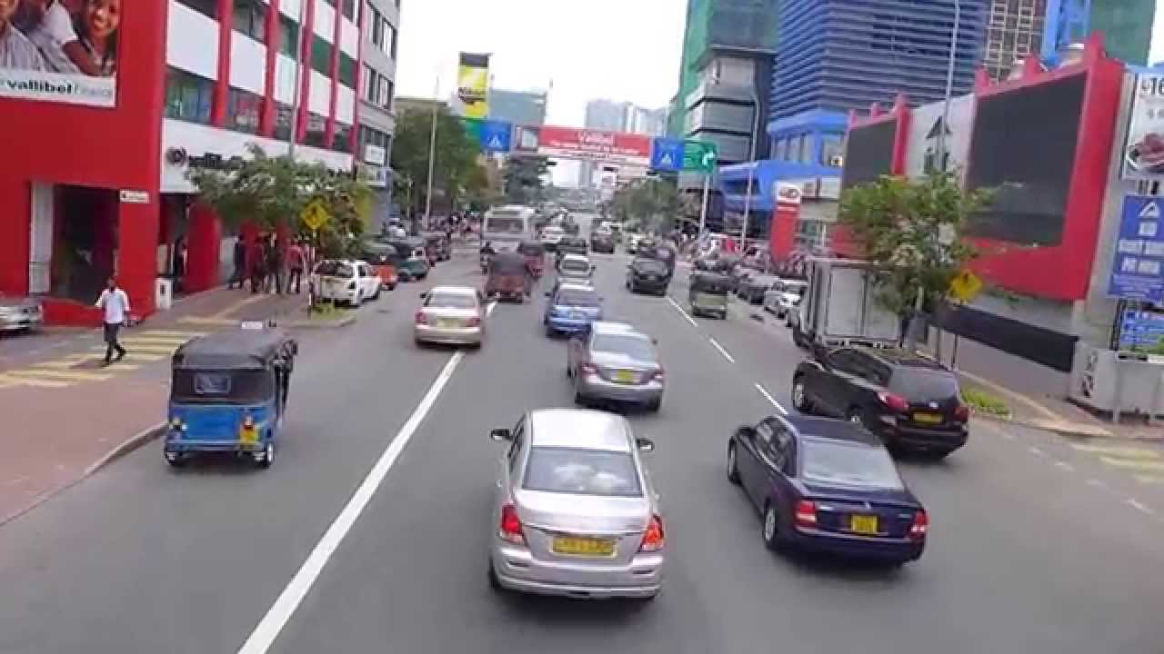
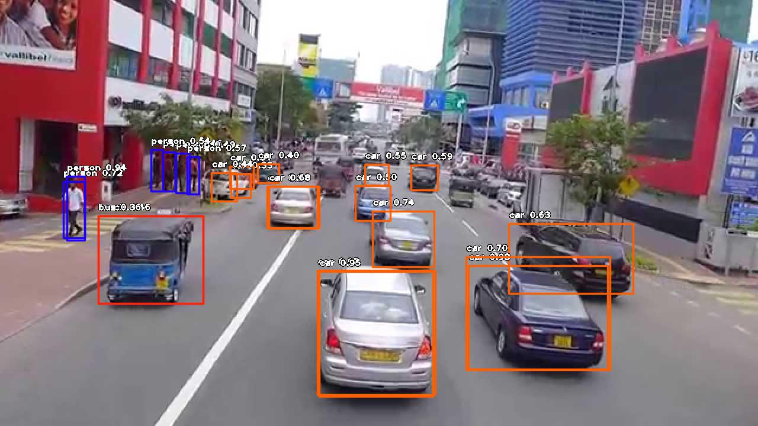
Original Image & Image after Object Detection-

Slide 9
CONCLUSION
An accurate and efficient object detection system has been developed which achieves comparable metrics with the existing state-of-the-art system. This project uses recent techniques in the field of computer vision and deep learning. Custom dataset was created using labelling and the evaluation was consistent. These results come at some computational cost at training time, one needs to train a network per object type and mask type.

Slide 10
REFERENCES
• Book Opencv computer vision with python by Joseph Howse, Prateek Joshi and Michael Beyeler
• International Research Journal of Engineering and Technology (IRJET) paper on Face Detection and Recognition using OpenCV and Python
• Python with deep learning,
• https://www.tutorialspoint.c
• Face Detection and Tracking using OpenCV.
• S.V.Viraktamath, Mukund Katti, Aditya Khatawkar, Pavan Kulkarni. 3, s.l.: SIJ, July August 2013, The Standard International Journals (The SIJ) , Vol. 1, pp. 45-50. ISSN: 2321 – 2403
• https://www.google.com/amp/s/learnopencv.com/amp/

Slide 11
THANK YOU!

